Slide 1
Loan Default Risk Analysis
By: Shaili Likhar

Slide 2
Objective
This project aims to identify patterns indicating whether a client may have difficulty paying their loan installments.
Business Goal: To assist the bank in making informed decisions such as denying loans, adjusting loan amounts, or lending to risky applicants at higher interest rates.

Slide 3
Data Overview
Datasets Used:
- application_data.csv
- previous_application.csv
- columns_description.csv
Overview:
- Application Data: Contains information about loan applications.
- Previous Application: Contains information about previous loan applications for the same clients.
- Columns Description: Provides descriptions for columns in the datasets.

Slide 4
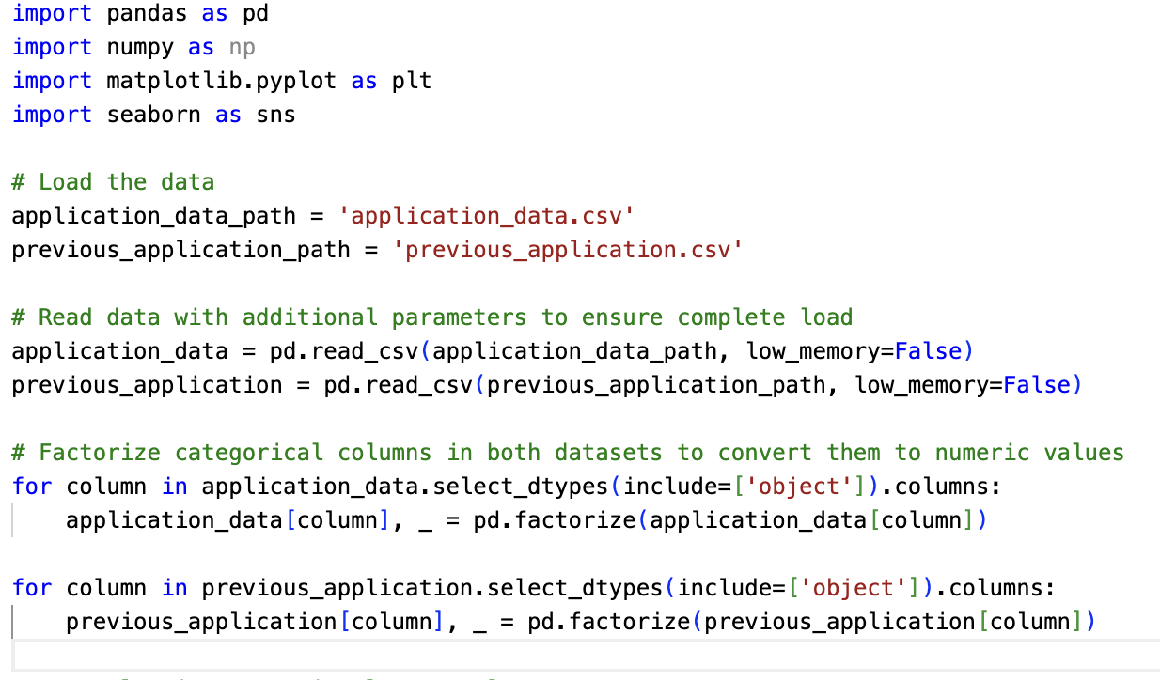
Data Loading & Preparation: Code

Slide 5
Data Loading & Preparation: Explanation
Step 1: Import Libraries
Step 2: Load the Data
Step 3: Factorize Categorical Columns
The essential Python libraries are imported to handle data processing (pandas), numerical operations (numpy), and data visualization (matplotlib, seaborn).
These libraries provide the necessary tools to manipulate data, perform analysis, and visualize the results effectively.
The application_data.csv and previous_application.csv files are loaded into the environment.
The low_memory=False parameter ensures that the files are fully loaded and does not lead to incorrect data types.
Categorical columns in both datasets are factorized (converted to numeric values).
Factorizing categorical variables allows for easier handling in analysis and modeling, especially when working with correlation matrices or machine learning algorithms that require numeric input.

Slide 6
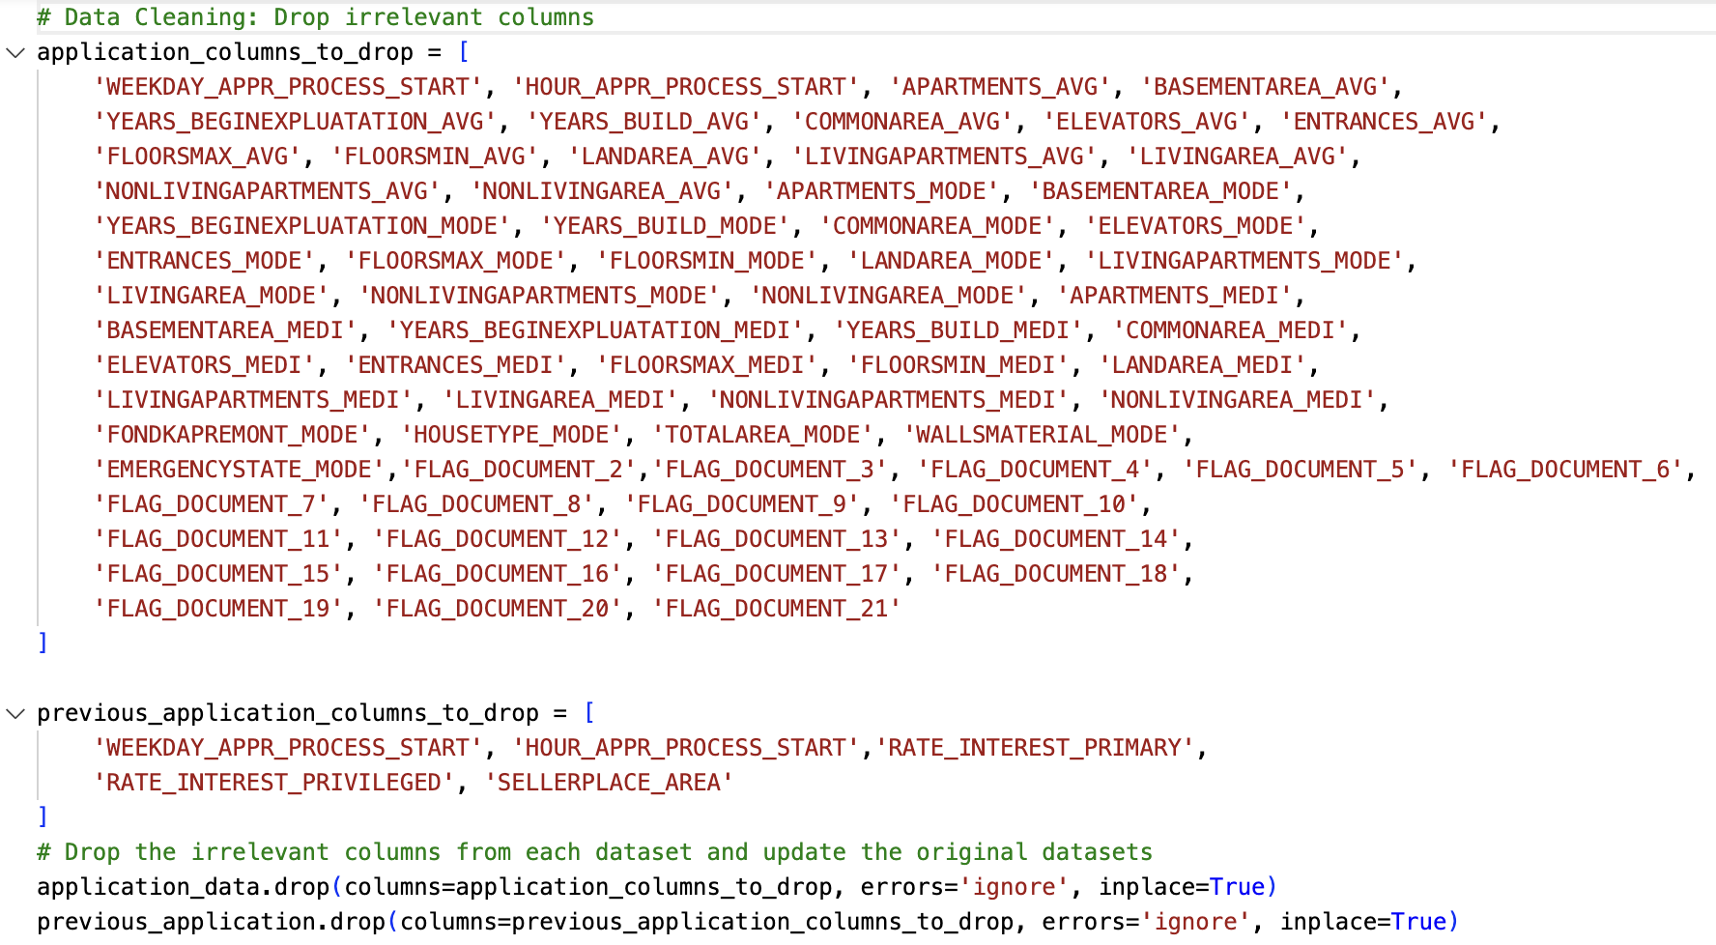
Data Cleaning Process: Code

Slide 7
Data Cleaning Process: Explanation
Purpose
Identifying
Irrelevant Columns:
Examples of Irrelevant Columns:
Dropping Columns:
Columns like APARTMENTS_AVG, BASEMENTAREA_MODE, and YEARS_BUILD_MEDI provide data not directly linked to loan default risk.
Document flags (FLAG_DOCUMENT_*) and timestamps are operational and do not indicate client risk.
data cleaning is necessary to streamline the dataset by removing columns that do not contribute meaningfully to the analysis
columns either contain redundant information, have low variance, or are not directly relevant to understanding the factors that drive loan default.
The irrelevant columns were removed from both datasets using the drop method to simplify the data, focus on meaningful variables, enhance pattern identification, and reduce computational load.

Slide 8
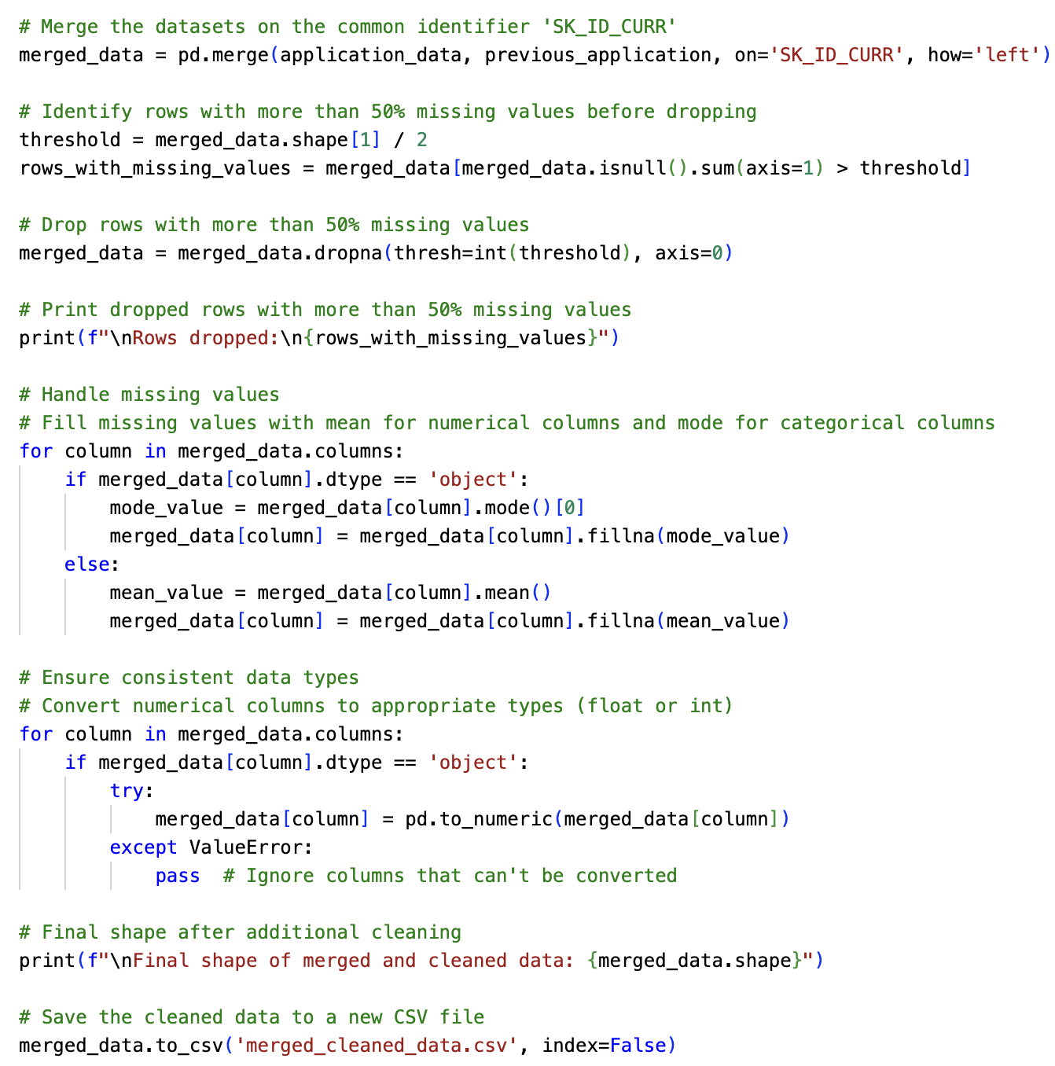
Data Merging & Handling Missing Values
Merging Datasets:
Action: The application_data and previous_application datasets were merged on the common identifier SK_ID_CURR.
Reason: Merging the datasets ensures a comprehensive view of each client's profile and loan history, which is crucial for accurately analyzing factors influencing loan defaults.
Handling Missing Values:
Identification: Rows with more than 50% missing data were identified.
Action: These rows were dropped to maintain data quality.
Reason: Removing rows with excessive missing values reduces noise and enhances the reliability of the analysis, ensuring that only robust data is considered in the EDA.

Slide 9
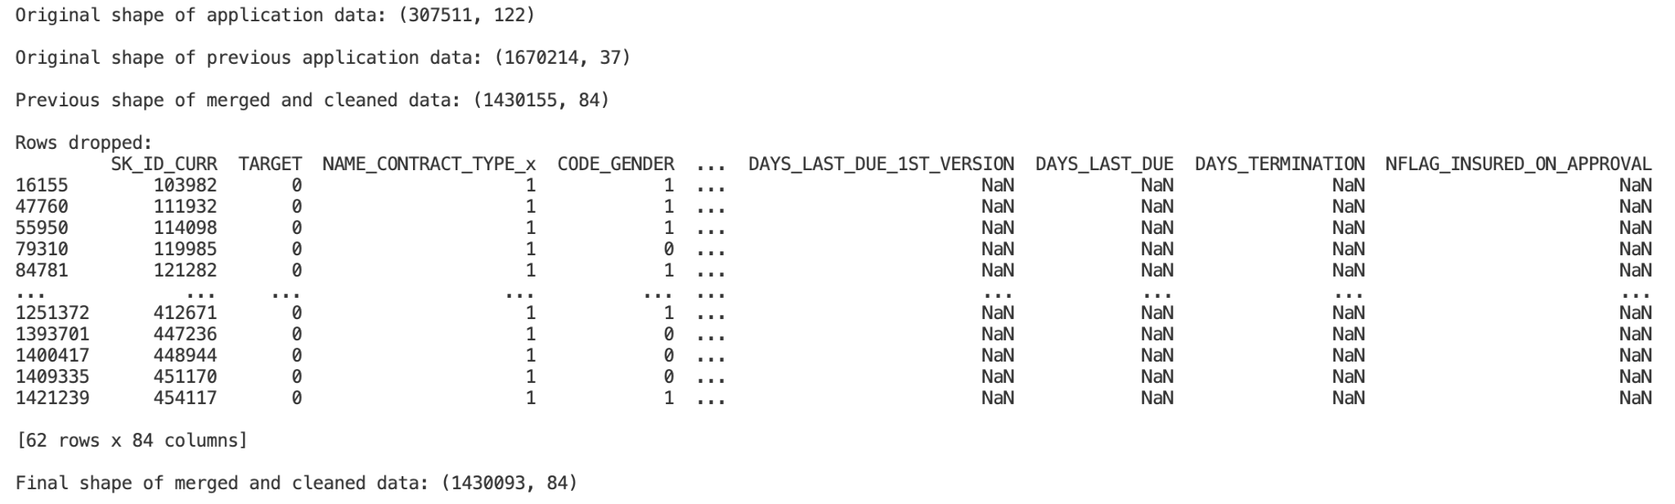
Outcome of Data Cleansing & Merging
Data is ready for analysis!
Data Integrity: The final dataset is now more reliable, with irrelevant and incomplete data removed, ensuring that the analysis will be based on high-quality information.
Enhanced Focus: By reducing the dataset to its most meaningful features, the analysis will be more focused on identifying key factors influencing loan default, leading to more accurate and actionable insights.
Efficiency: Streamlining the dataset not only improves computational efficiency but also simplifies the analysis process, allowing for clearer interpretation of the results.

Slide 10
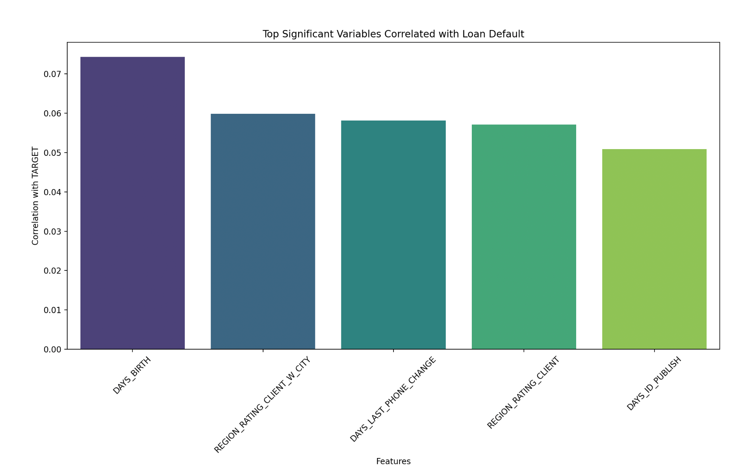
Key Features Identified
The top features identified as strong indicators of loan default:
DAYS_BIRTH
REGION_RATING_CLIENT_W_CITY
DAYS_LAST_PHONE_CHANGE
REGION_RATING_CLIENT
DAYS_ID_PUBLISH

Slide 11
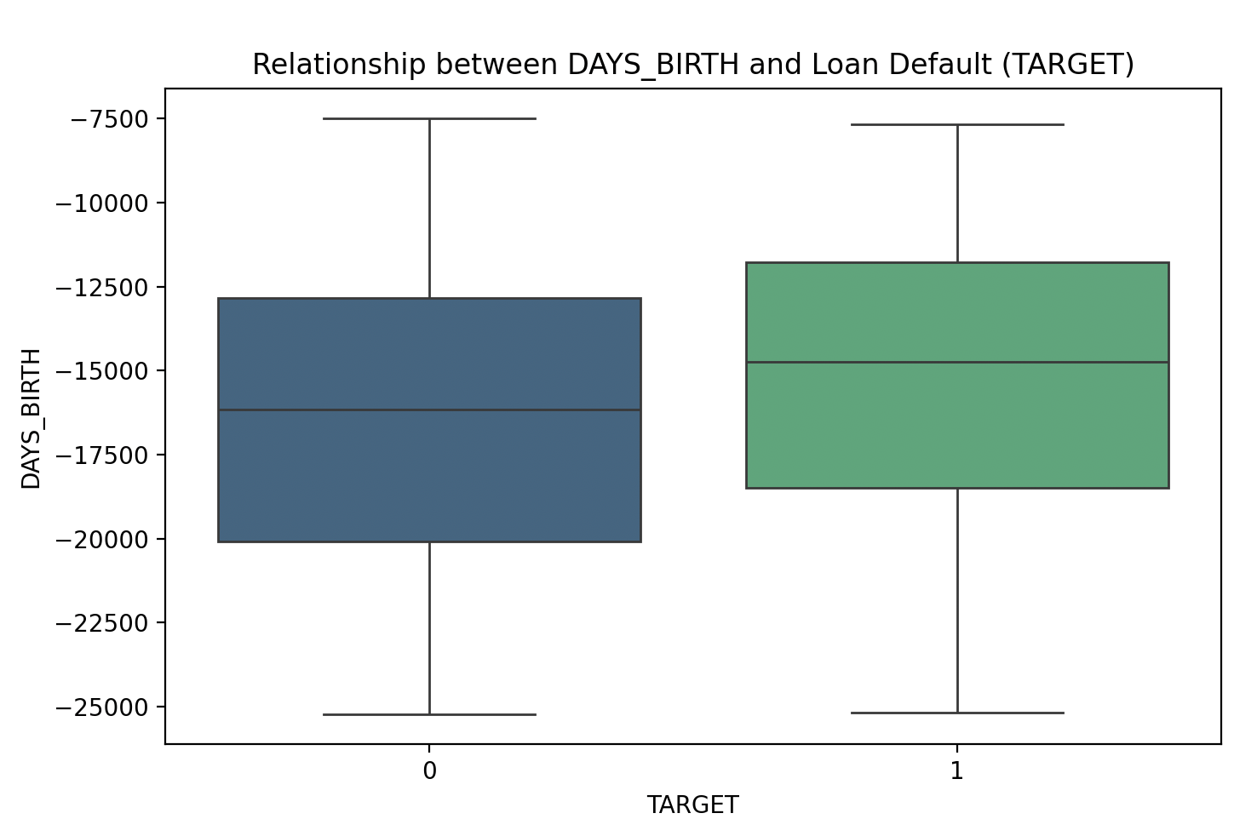
Impact of Age on Loan Default
DAYS_BIRTH and Loan Default:
DAYS_BIRTH represents the client's age in days.
It has the highest correlation with loan default, indicating that age is a significant predictor of whether a client will default on a loan.
Insight:
Older clients tend to have a lower risk of default, as suggested by the positive correlation between DAYS_BIRTH and the target variable.
Younger clients tend to have a high risk of default, as they are less financially stable, have lower credit history, and higher debt-to-income ratios

Slide 12
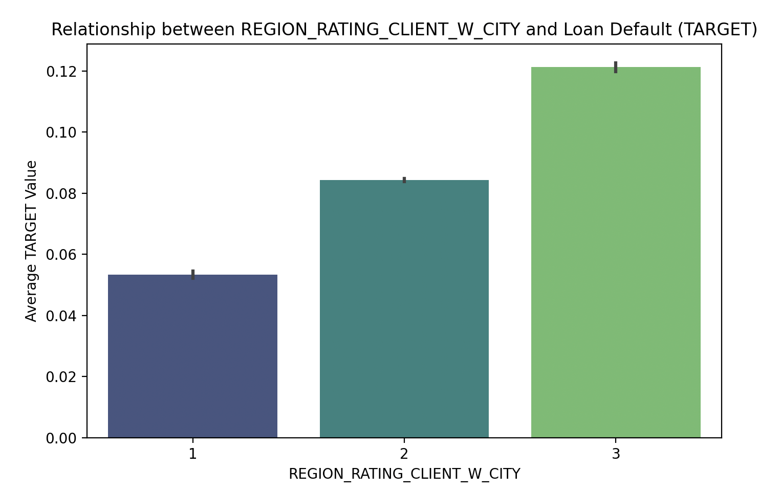
Impact of Region Rating with City on Loan Default
REGION_RATING_CLIENT_W_CITY and Loan Default:
REGION_RATING_CLIENT_W_CITY reflects the rating of the client’s region in conjunction with the city.
This variable has a moderate positive correlation with loan default, suggesting that the client's regional rating combined with city factors influences default risk.
Insights:
As the region rating decreases (moving from 1 to 3), the average default rate increases.
Level 1 (Highest Rating): Clients from regions with the highest rating have the lowest average default rate, around 6%.
Level 2 (Moderate Rating): Clients from moderately rated regions show a higher average default rate, approximately 8%.
Level 3 (Lowest Rating): Clients from the lowest-rated regions exhibit the highest average default rate, close to 12%.
Regions with low ratings tend to have poorer economic conditions, clients that face higher living costs but have lower incomes, and have less access to financial services and resources

Slide 13
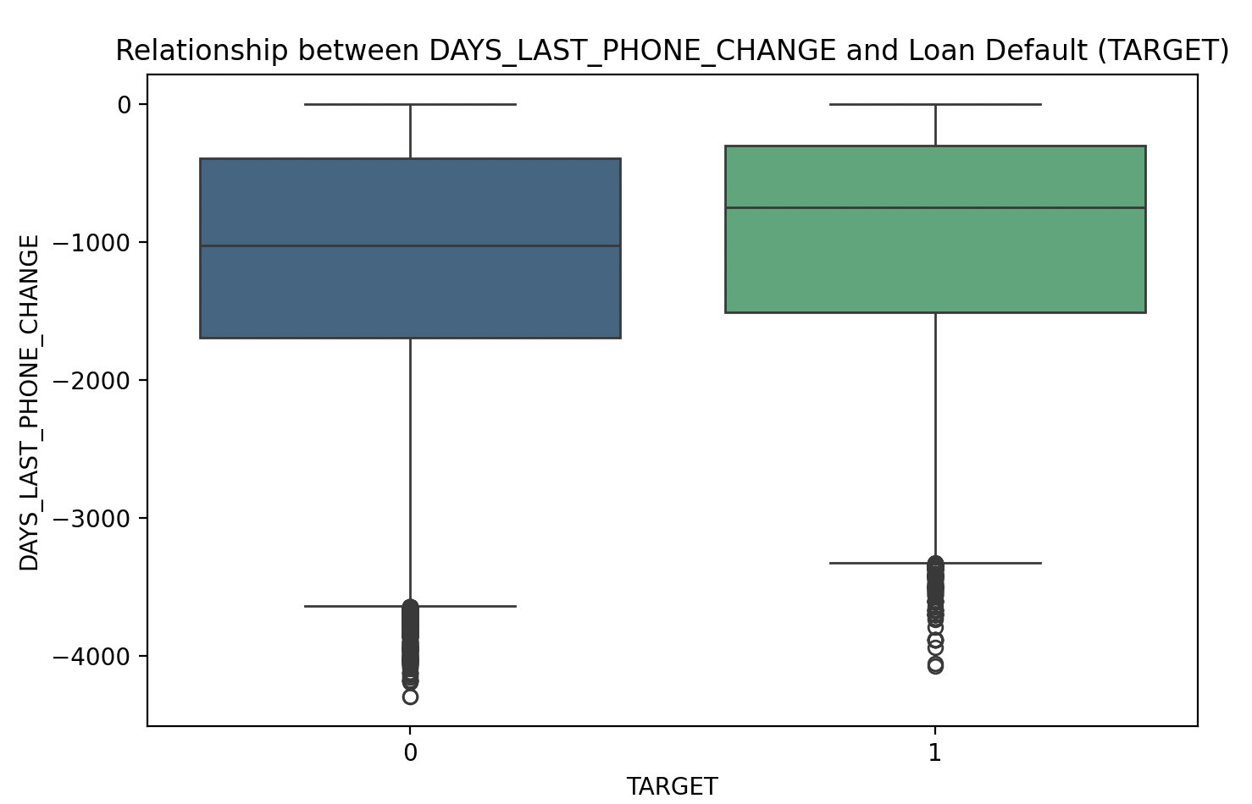
Phone Change Frequency and Loan Default
DAYS_LAST_PHONE_CHANGE and Loan Default:
DAYS_LAST_PHONE_CHANGE represents the number of days since the client last changed their phone number.
This variable shows a positive correlation with loan default, indicating that frequent phone number changes may be a red flag.
Insight:
Clients who have changed their phone numbers more recently may have a higher risk of default, potentially indicating increased financial instability
Outliers:
Despite more recent phone change outliers in the non-default group, the overall trend shows recent phone changes generally correlate with higher default risk, making it a significant factor when combined with other variables

Slide 14
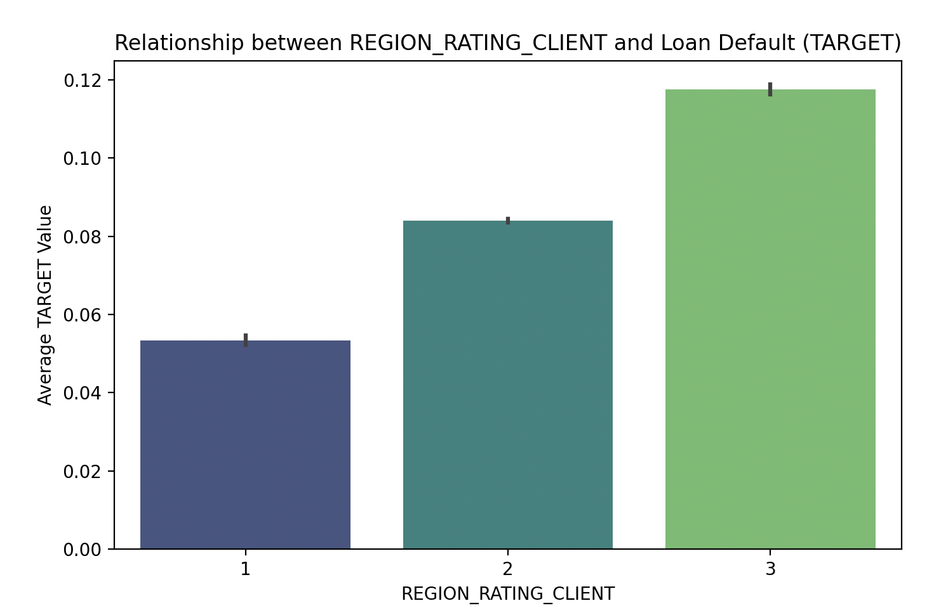
Influence of Region Rating on Loan Default
REGION_RATING_CLIENT and Loan Default:
REGION_RATING_CLIENT reflects the client's region rating without considering the city
It shows a moderate correlation with loan default, making region alone a significant factor in default risk..
Insight:
The chart shows a clear trend: as the region rating decreases (from 1 to 3), the likelihood of loan default increases.
Clients in higher-rated regions have the lowest default rate (~6%), while those in the lowest-rated regions have the highest (~12%).
This suggests that socio-economic conditions in lower-rated regions significantly impact clients' ability to repay loans, increasing their susceptibility to default.

Slide 15
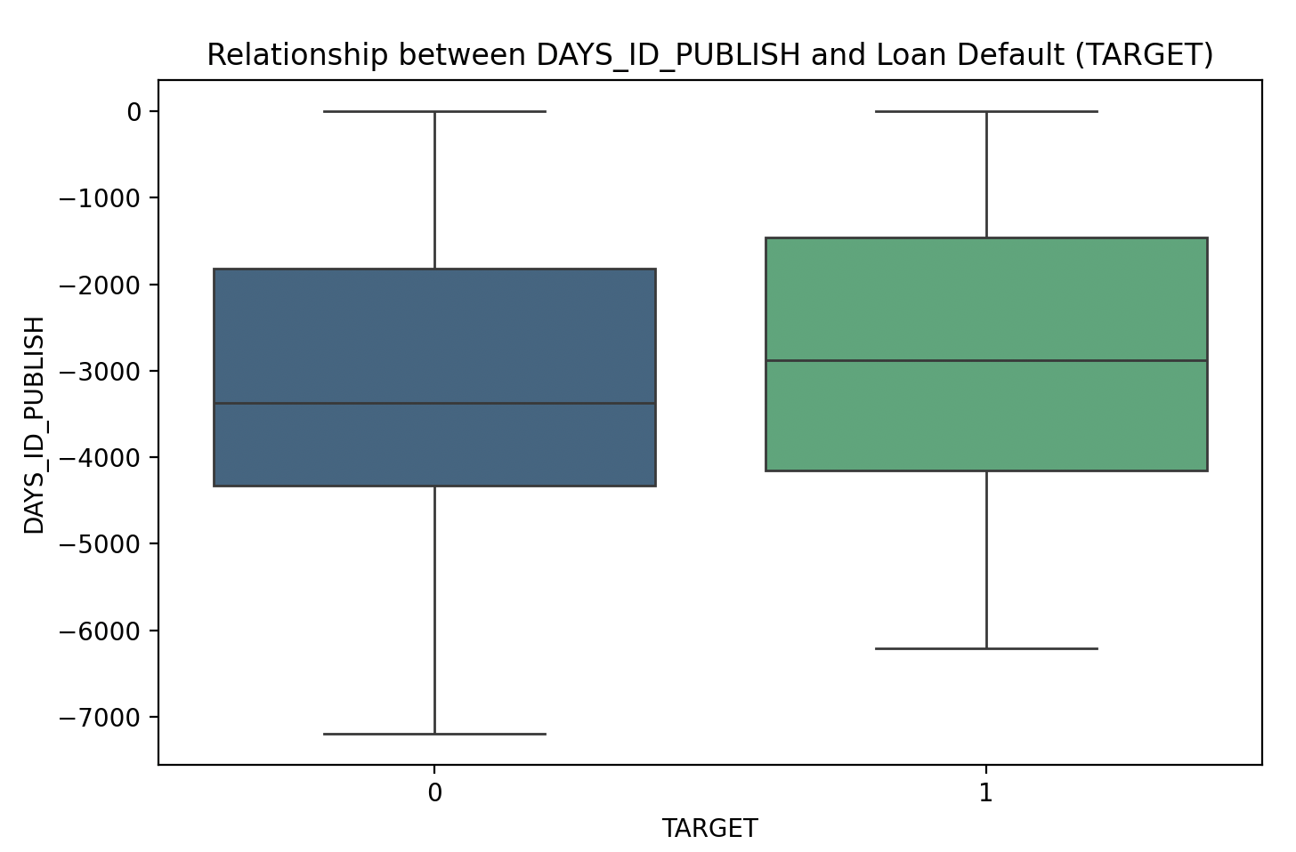
ID Document Publication and Loan Default
DAYS_ID_PUBLISH and Loan Default:
DAYS_ID_PUBLISH represents the number of days since the client’s ID document was published.
This variable has the lowest positive correlation among the top five, but still suggests that the recency of ID publication can influence default risk.
Insight:
The chart suggests that clients whose IDs were published more recently may be more likely to default on loans
This implies that recent changes in a client's legal documentation or identity status might be linked to financial instability or risk, contributing to a higher likelihood of default.

Slide 16
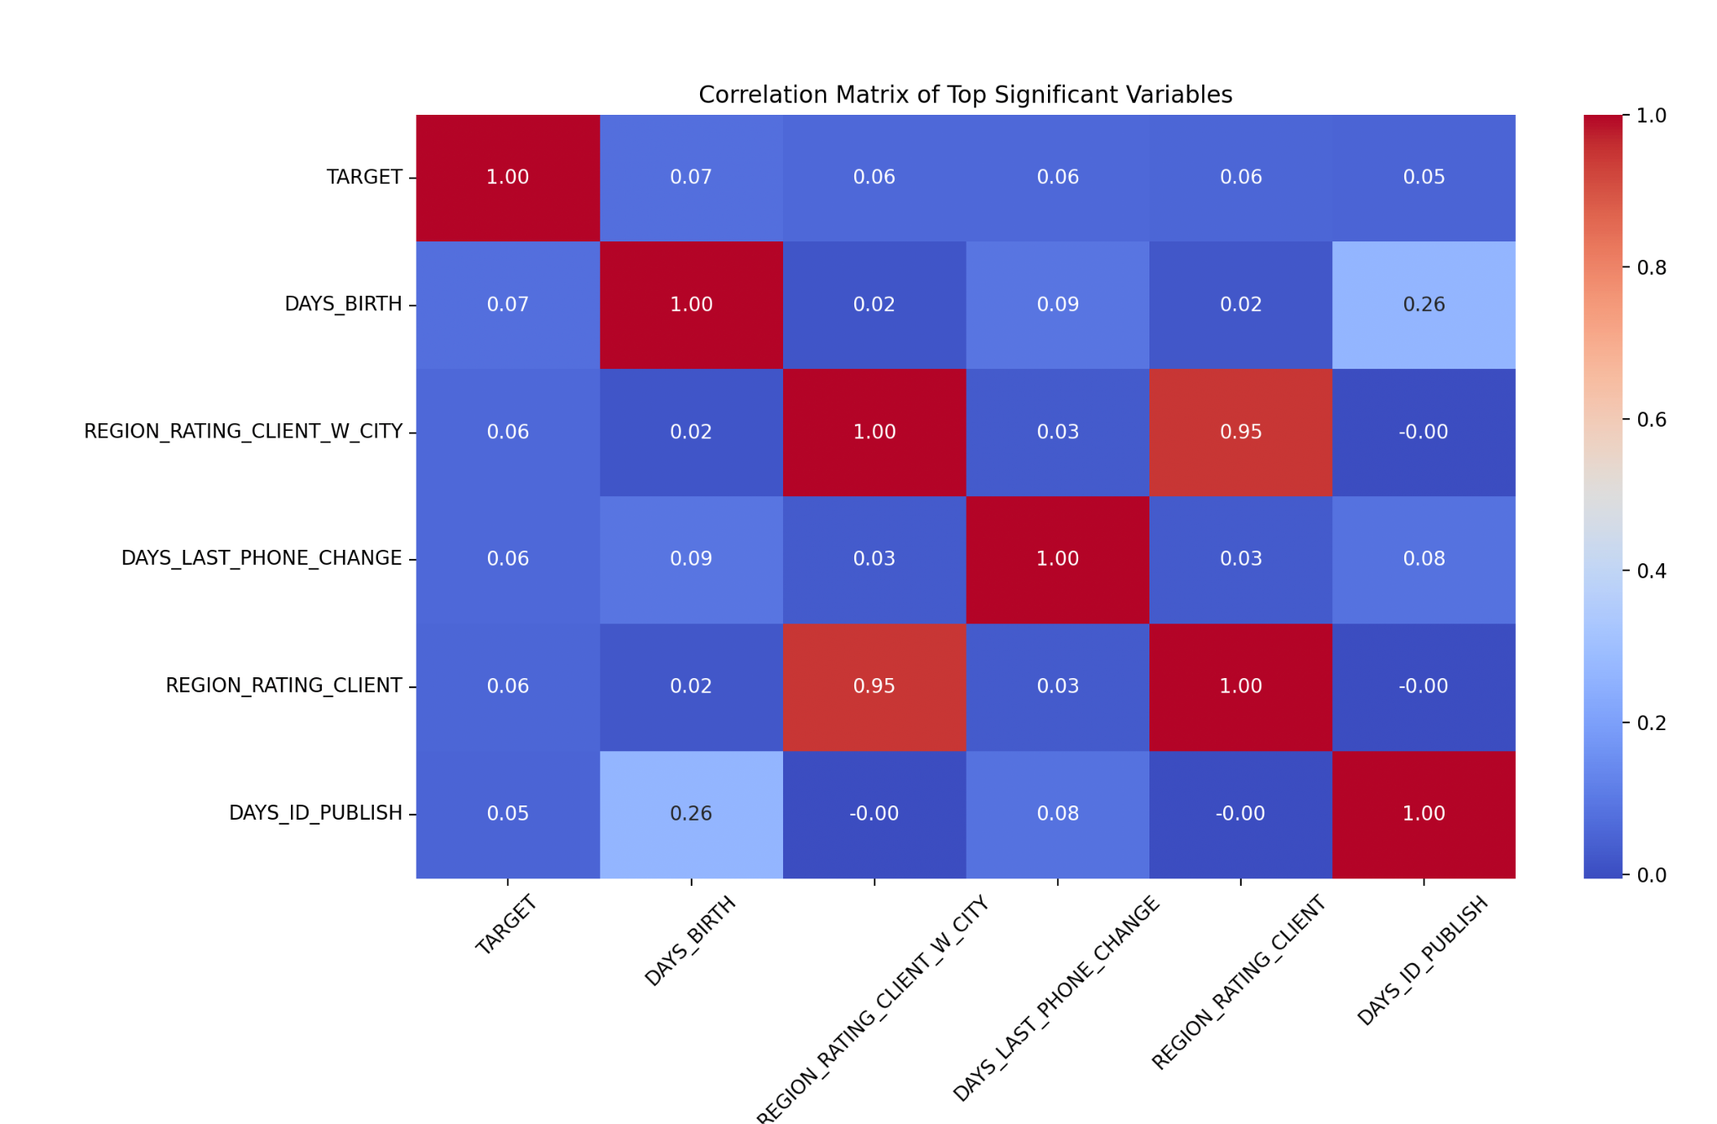
Correlation Matrix

Slide 17
Correlation Matrix Insights
TARGET Correlations:
The variables DAYS_BIRTH, REGION_RATING_CLIENT_W_CITY, DAYS_LAST_PHONE_CHANGE, REGION_RATING_CLIENT, and DAYS_ID_PUBLISH all show positive correlations with loan default, indicating they are significant factors in assessing default risk.
Inter-variable Correlations:
REGION_RATING_CLIENT and REGION_RATING_CLIENT_W_CITY have a very high correlation (0.95), indicating that they provide overlapping information about regional ratings.
DAYS_ID_PUBLISH also shows a notable correlation with DAYS_BIRTH (0.26), linking ID publication recency with the client's age.

Slide 18
Conclusion
The analysis identified key variables linked to loan defaults, including the client’s age in days, the region rating of the city the client lives in, the number of days since the client last changed their phone number, and the number of days since they updated their identity document
Strong correlations were observed between region-related variables and loan default, indicating that socio-economic factors tied to a client's location are crucial in assessing default risk.
Age and recency of ID publication were also notable predictors, suggesting that both demographic and administrative factors play a role in default likelihood.

Slide 19
Implications
Banks can use these insights to refine their risk assessment models, focusing on these key factors to better predict and mitigate the risk of loan defaults.
Identifying high-risk clients allows for proactive measures, such as adjusting loan terms or offering financial counseling, to reduce the likelihood of defaults.

Slide 20
Next Steps
Further analysis could explore additional variables or apply machine learning models to improve predictive accuracy.
Implementation of these findings into the bank’s decision-making process could enhance loan portfolio performance and reduce financial risk.

Slide 21
Thank You
Contact Information:
Email: shaililikhar@gmail.com
LinkedIn: https://www.linkedin.com/in/shaili-likhar/
I appreciate your time and attention.

